Slide 1

Unlocking Box Office Success:
Predicting Movie Popularity
UCB Data Analytics Bootcamp - Project 4
Group 6:
Gursimran Kaur (Simran)
Jeff Kim
Rose Mary Rios
Notes:
Data Sources:
TMDB 5000 Movies Dataset
Oscar Best Picture Movies Dataset

Slide 2

Project Overview
ETL Highlights
EDA Highlights
Machine Learning Data Preparations
ML - Baseline Models → Performant Model
Machine Optimizations

Slide 3

Project Overview
Objective: This project seeks to predict movie popularity scores by leveraging advanced machine learning models. By analyzing a rich dataset of historical movie data, our models will uncover the key factors driving a movie's success, offering critical insights for producers and marketers.
Data Source: Kaggle’s TMDB 5000 Movie and Oscar Best Picture Movies Datasets
Challenge: Identifying which features had the most impact on predicting popularity.
Assumptions:
Winning or being nominated for Oscars boosts popularity
Big-name directors and famous actors make movies more popular
Higher budgets lead to more popular movies
Popular genres draw more audiences
tps://www.kaggle.com/datasets/martinmraz07/oscar-movies)
Notes:
This project aims to develop Linear Regression and Random Forest models to predict a movie's popularity score based on features like budget, runtime, genre, and user ratings.
Our goal is to enable stakeholders in the movie industry to estimate a film's potential popularity before its release. By analyzing historical movie data, our predictive models will identify key attributes that influence success, providing producers and marketers with valuable insights.
### Methods Used
This structured approach includes data cleaning, feature engineering, model selection, evaluation, and iterative optimization, demonstrating a full-spectrum understanding of the data analytics and machine learning workflow:
- ETL (Extract, Transform, Load): Prepare the data by extracting it from sources, transforming it for analysis, and loading it into a structured format.
- EDA (Exploratory Data Analysis): Analyze the dataset to understand its structure, patterns, and potential insights.
- Model Selection: Choose an appropriate machine learning model based on the problem and dataset characteristics.
- Baseline Model Performance: Train the initial model and evaluate its performance using baseline metrics.
- Performant Model Comparison: Experiment with other an alternative model to compare their performance against the baseline.
- Identify Best-Performing Model: Select the model that achieves the best results based on accuracy, precision, or other metrics.
- Iterative Optimization Processing: Fine-tune the best model to improve its performance, aiming to meet or exceed a specific performance threshold, such as 75% accuracy.
### Data Sources
- TMDB 5000 Movie Dataset = Movie & credit kaggle.com/datasets/tmdb/tmdb-movie-metadata)
- Oscar Best Picture Movies](ht

Slide 4
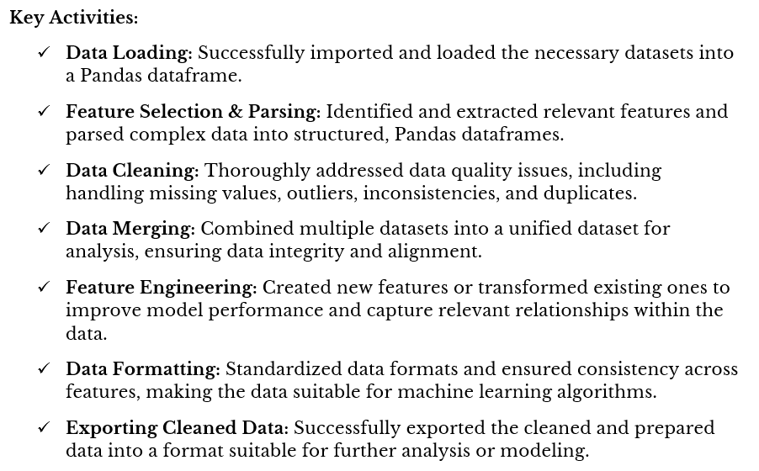
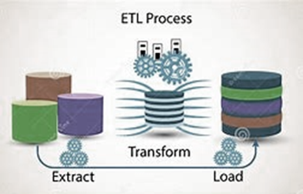
ETL Highlights
Notes:
Key Activities:
Data Loading: Successfully imported and loaded the necessary datasets into the machine learning environment.
Feature Selection & Parsing: Carefully identified and extracted relevant features from the data, ensuring data consistency and accuracy.
Data Cleaning: Thoroughly addressed data quality issues, including handling missing values, outliers, inconsistencies, and duplicates.
Data Merging: Combined multiple datasets into a unified dataset for analysis, ensuring data integrity and alignment.
Feature Engineering: Created new features or transformed existing ones to improve model performance and capture relevant relationships within the data.
Data Formatting: Standardized data formats and ensured consistency across features, making the data suitable for machine learning algorithms.
Exporting Cleaned Data: Successfully exported the cleaned and prepared data into a format suitable for further analysis or modeling.
Overall Assessment:
The data preparation and cleaning process was comprehensive and thorough, laying a solid foundation for the machine learning project. The efforts to select relevant features, address data quality issues, and engineer new features will likely contribute to the model's accuracy and performance.
Realized Benefits:
Data quality in this machine learning project results in quick resolve
Value of feature engineering in extracting meaningful information from the data.
Careful data cleaning to ensured data consistency and accuracy.

Slide 5
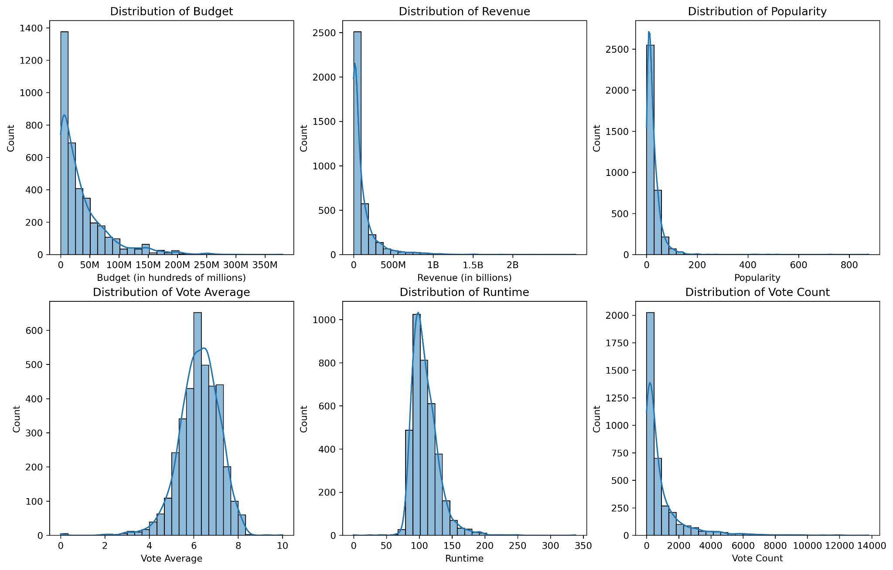
EDA Highlights
Budget, revenue, popularity, and vote count have a right skewed distribution
Shows extreme outliers
Vote average and runtime have a normal distribution
Notes:
Budget Distribution:
Highly skewed to the right, with most movies having budgets under $50 million.
A few outliers with budgets exceeding $200 million.
Implication for ML Models: Log transformation can help normalize the skewed distribution and reduce the impact of extreme outliers.
Revenue Distribution:
Strong right skew, with most movies earning under $500 million.
Only a small number of movies grossing over $1 billion.
Implication for ML Models: Similar to budget, a log transformation can normalize the skew and help the model focus on general patterns rather than being skewed by outliers.
Popularity Distribution:
Skewed to the right, with most movies having low popularity scores.
A few outliers with exceptionally high popularity.
Implication for ML Models: This suggests that most movies in the dataset are not widely popular, and the model might benefit from focusing on handling skewed distributions through transformations like logarithms.
Vote Average Distribution:
Fairly normal distribution, centered around 6-7.
Implication for ML Models: No transformation may be necessary since the vote average follows a nearly normal distribution, which is well-suited for many machine learning models.
Runtime Distribution:
Close to a normal distribution, with most movies around 100-150 minutes.
Implication for ML Models: Like vote average, no transformation may be necessary as the distribution is fairly normal.
Vote Count Distribution:
Strongly skewed to the right, with most movies receiving under 2,000 votes.
A small number of movies have extremely high vote counts (over 10,000).
Implication for ML Models: Log transformation on vote count would help balance the skewed distribution and reduce the model's sensitivity to extreme values.

Slide 6
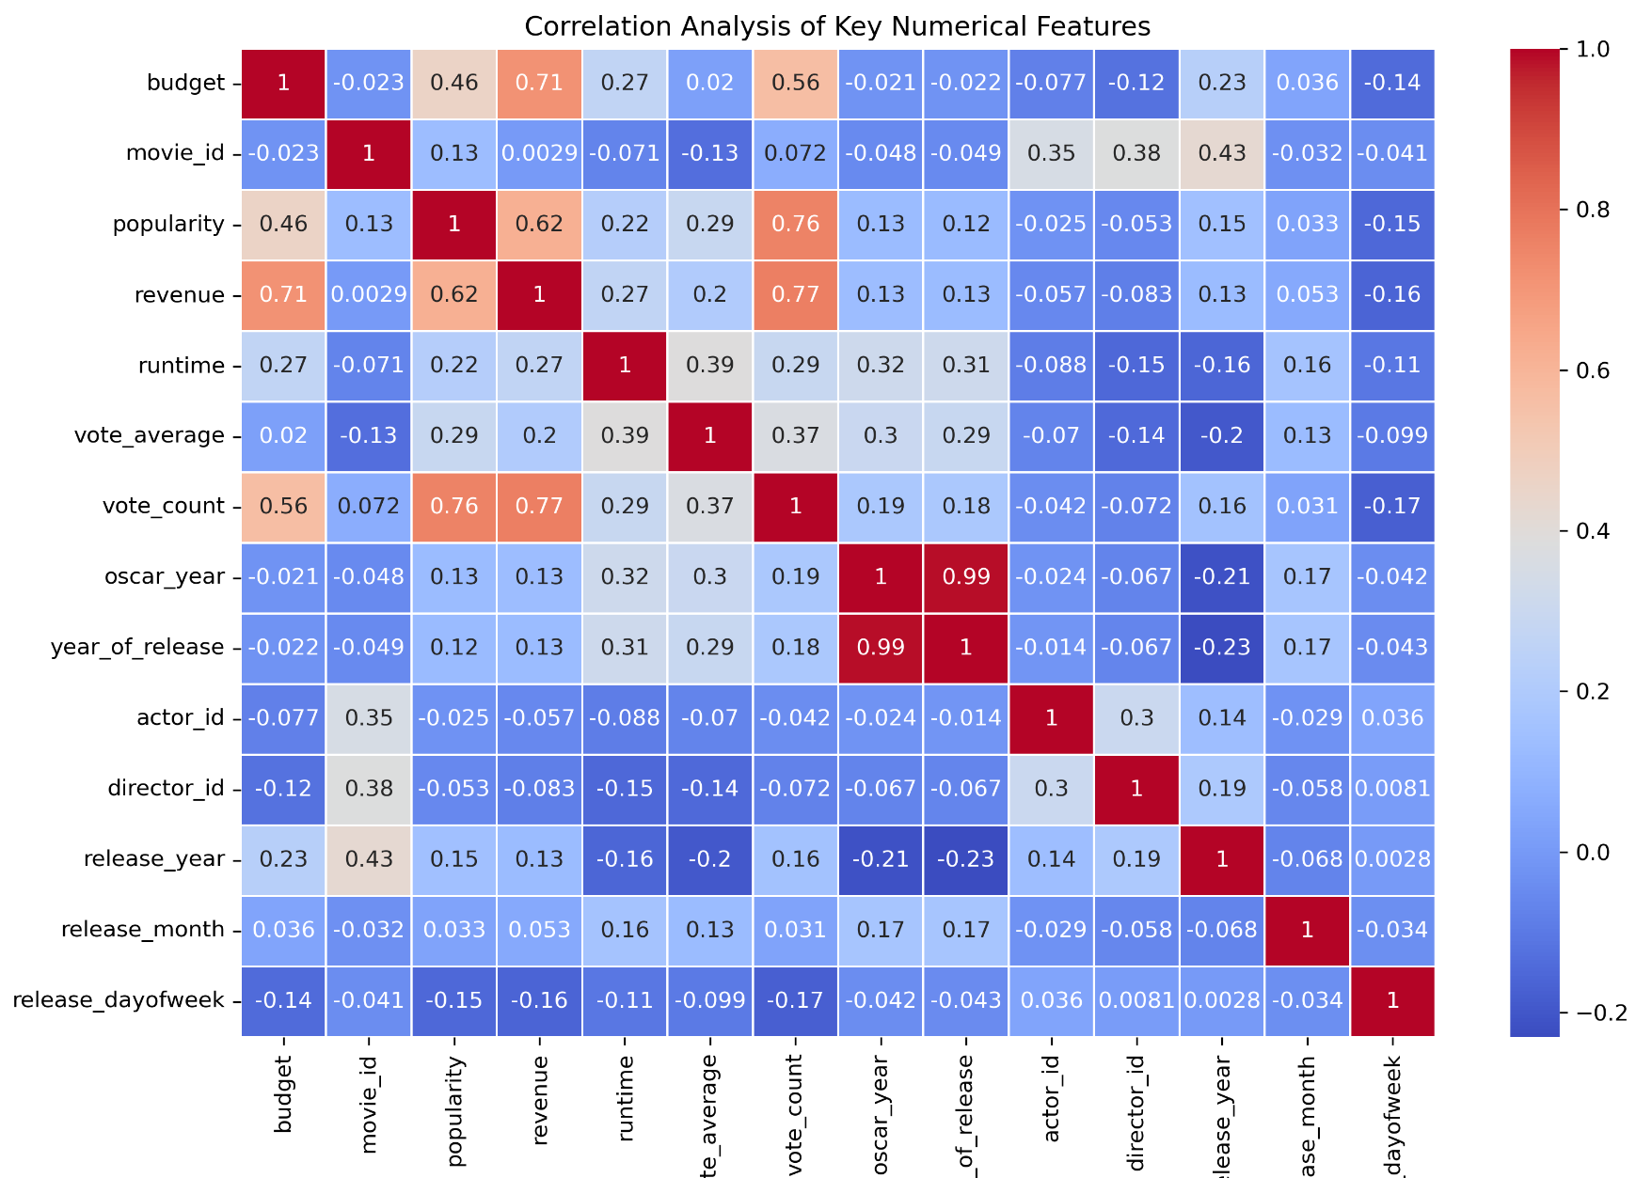
EDA Highlights
Budget and popularity: Movies with higher budgets and popularity tend to have higher revenues.
Vote count and revenue: A strong correlation exists between vote count and revenue, indicating the importance of audience engagement.
Runtime and revenue: While the correlation is moderate, longer movies might have higher revenue potential.
Oscar wins: Winning an Oscar doesn't necessarily correlate strongly with budget or release year.
Notes:
Key Highlights from the Correlation Heatmap
Correlation Heatmap Analysis
(focus on areas where ther are lots of variations
The provided correlation heatmap offers valuable insights into the relationships between various numerical features in the movie data. Here are some key highlights:
Strong Positive Correlations:
Budget vs. Revenue: A strong positive correlation indicates that movies with higher budgets tend to have higher revenues.
Popularity vs. Revenue: Similarly, movies with higher popularity ratings often have higher revenues.
Vote Count vs. Revenue: Movies with more votes tend to have higher revenues, suggesting a correlation between audience engagement and commercial success.
Vote Count vs. Popularity: A strong positive correlation between vote count and popularity indicates that movies with more votes are generally perceived more favorably by audiences.
Moderate Positive Correlations:
Runtime vs. Revenue: While the correlation is not as strong as with other features, there's a positive relationship between movie runtime and revenue, suggesting that longer movies may have higher revenue potential.
Vote Average vs. Revenue: A moderate positive correlation indicates that movies with higher average ratings tend to have higher revenues.
*****Negative Correlations:
Oscar Wins vs. Budget: A weak negative correlation suggests that winning an Oscar doesn't necessarily require a large budget.
Oscar Wins vs. Release Year: A slight negative correlation indicates that movies released in recent years might have slightly lower chances of winning Oscars compared to older movies.
Implications for Machine Learning:
These correlations can be valuable in machine learning modeling:
Feature Selection: The strong correlations between certain features and revenue can guide feature selection for predicting movie revenue.
Feature Engineering: New features can be created based on the observed correlations, such as interaction terms between budget and runtime.
Model Building: The identified correlations can help inform the choice of machine learning algorithms and the tuning of hyperparameters.
Understanding Relationships: The correlations provide insights into the underlying relationships between movie attributes and their success, which can be useful for understanding the movie industry.
Key Takeaways:
Budget and popularity: Movies with higher budgets and popularity tend to have higher revenues.
Vote count and revenue: A strong correlation exists between vote count and revenue, indicating the importance of audience engagement.
Runtime and revenue: While the correlation is moderate, longer movies might have higher revenue potential.
Oscar wins: Winning an Oscar doesn't necessarily correlate strongly with budget or release year.
By understanding these correlations, machine learning models can be built to more accurately predict movie revenue and identify key factors influencing success.

Slide 7
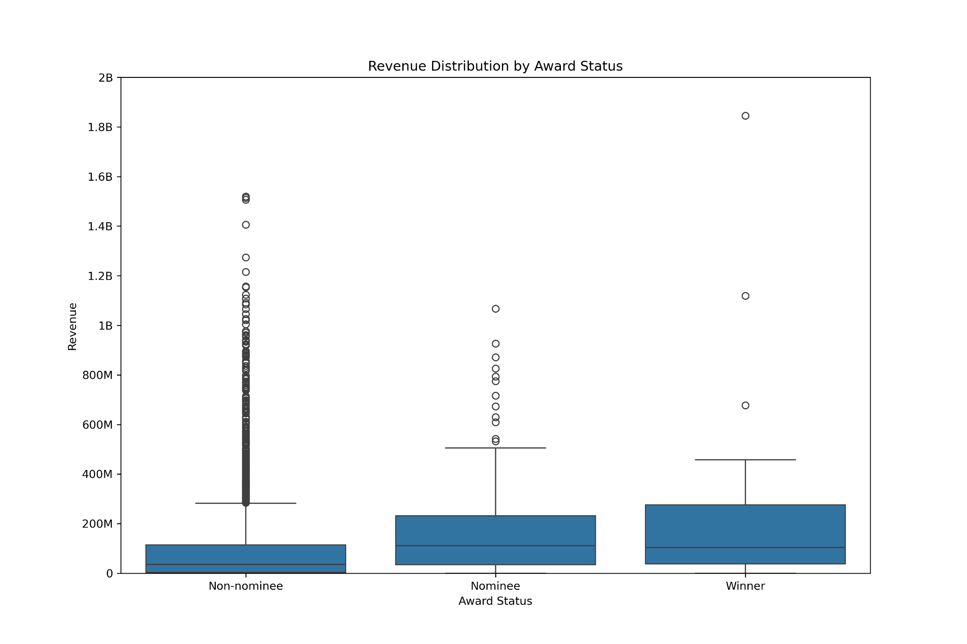
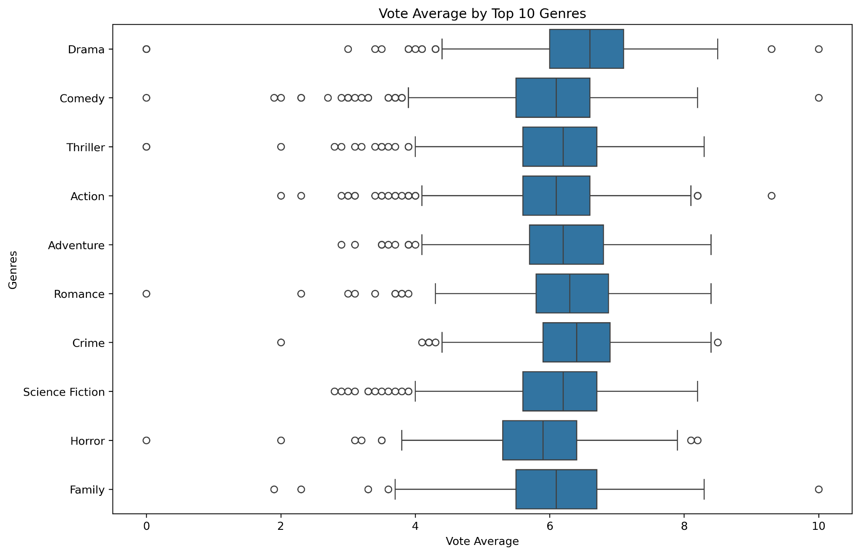
EDA Highlights
Nominees/Winners show consistent, higher medians revenue compared to non-nominees
Non-nominated movies have extreme outliers with very high revenue
Drama and Romance have a higher vote average = stronger audience approval
Comedy and Horror show wider variation and lower medians in vote average
Significant outliers in Family and Horror genres
Notes:
Chart 1: Vote Average by Top 10 Genres
Drama and Romance:
These genres show higher vote averages, indicating these movies generally receive better ratings.
Comedy and Horror:
These genres have more spread in their vote averages and show lower medians compared to others.
Implication: The model may need to treat these genres differently, as their vote averages vary more, which could affect prediction accuracy.
Outliers:
Outliers exist in all genres, especially in Family and Horror, where some movies received very low or very high votes compared to others.
Implication: Handling outliers is important to ensure the model doesn’t get skewed by these extreme cases.
Chart 2: Revenue Distribution by Award Status
Non-nominee vs. Nominee/Winner:
Non-nominees show a wider range of revenue, including more extreme outliers, while nominees and winners tend to have a narrower distribution with higher median revenues.
Implication: Award status (nominee or winner) is likely an important feature for predicting higher revenue, which can be included in the model for better accuracy.
Outliers in Non-nominees:
Non-nominees have more outliers with extremely high revenue, suggesting that not all box office success is linked to awards.
Implication: The model should account for non-award factors driving revenue and be aware of high-revenue outliers among non-nominated movies.

Slide 8
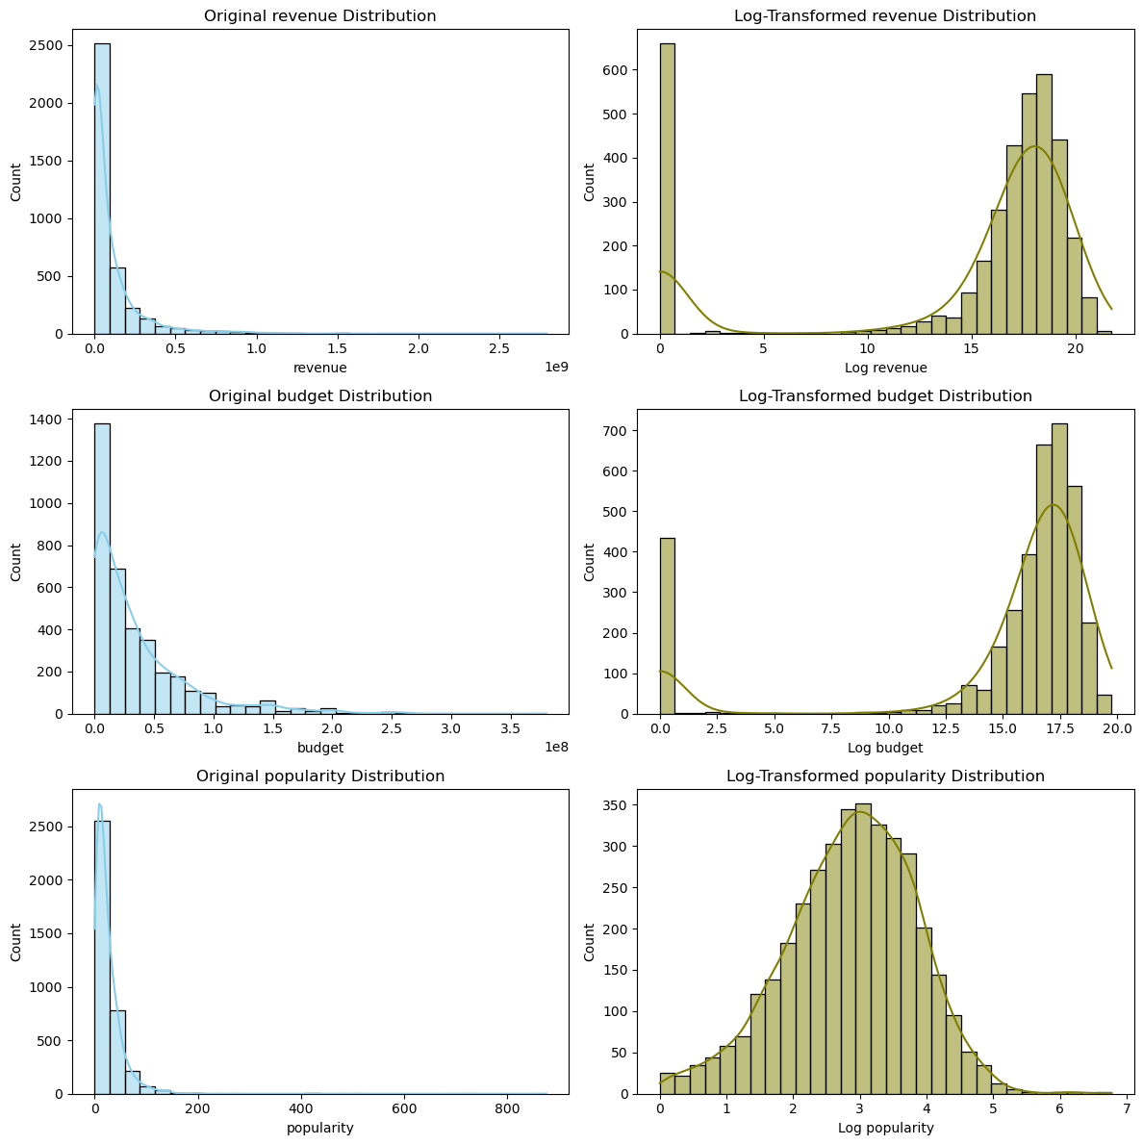
ML Data Preparation
Baseline Features: ‘budget’, ‘runtime’, ‘vote_average’, ‘release_month’, ‘release_dayofweek’, and ‘revenue’
Target: ‘popularity’
Data Preparation for Modeling
Feature Engineering:
Log Transformations to handle skewed data and outliers
Interaction Terms multiplying budget and runtime to capture combined relationship
Label Encoding on categorical features by transforming release_month and release_dayofweek into numerical values
Cyclic Transformation of month and day to represent their circular nature
Notes:
Why Log Transformation was chosen:
Works well with continuous data like revenue
The log function compresses the scale of large values while preserving the order of the data
Brings data closer to normal distribution, reducing impact of outliers without removing them

Slide 9
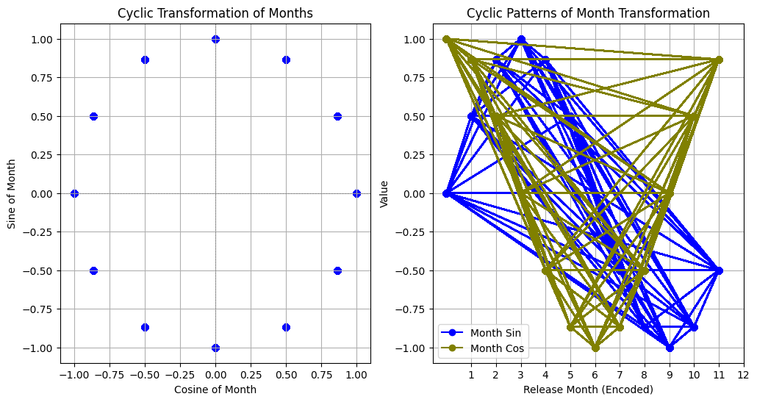
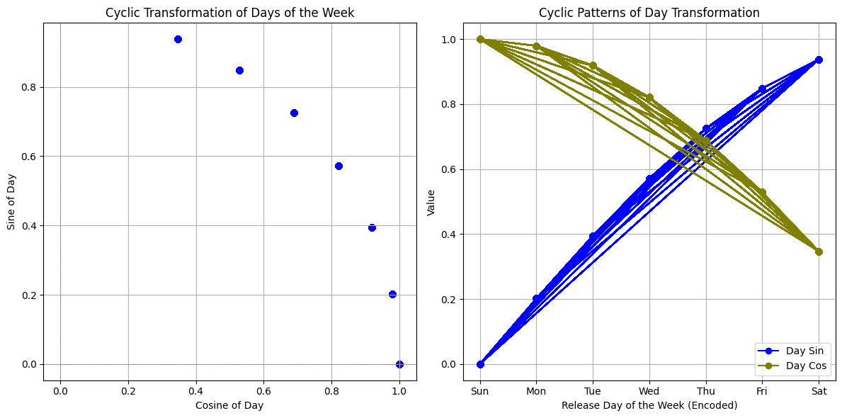
ML Data Preparation
Cyclic Encoding was used to :
Teach the model patterns: We anticipated it to help the model recognize patterns data that repeat over and over, like the days of the week.
Make better predictions: The intent was for better understanding of patterns. The model was enabled to make better guesses about what might happen next. For example, knowing movie sales are usually higher on weekends, it can predict higher sales for a Saturday.
Notes:
The specific visualizations you've shared are valuable for understanding the cyclical nature of time-based features and the performance of the model. They provide insights into the distribution of residuals, feature importance, and the relationship between actual and predicted values.
Connecting Cyclic Visualizations to Model Understanding
The cyclic visualizations you've shared provide valuable insights into the cyclical nature of time-based features and the performance of the machine learning model.
Here's how these visualizations contribute to our understanding:
1. Understanding Cyclic Patterns:
Sine and Cosine Transformations: The visualizations demonstrate the use of sine and cosine functions to capture the cyclical nature of time-based features like days of the week or months. This is crucial for models dealing with seasonal or periodic data.
Visual Representation: The plots visually represent the periodic patterns created by these transformations, making it easier to understand how the model is capturing these cyclical relationships.
2. Relating to Model Performance:
Feature Importance: The visualizations can be used to assess the importance of these cyclic features in the model. If the features are found to be significant, it indicates that the model is effectively capturing the cyclical patterns in the data.
Residual Analysis: By examining the residuals (the difference between actual and predicted values) in relation to the cyclic features, we can assess how well the model is handling the cyclical patterns. If the residuals show a cyclical pattern, it might suggest that the model is not fully capturing the cyclic nature of the data.
3. Overall Model Evaluation:
Complementary Insights: The cyclic visualizations, in combination with other evaluation metrics like R-squared or mean squared error, provide a more comprehensive understanding of the model's performance.
Identify Areas for Improvement: If the visualizations reveal that the model is struggling to capture the cyclical patterns, it might suggest the need for further feature engineering or model adjustments.
In summary, the cyclic visualizations offer a visual representation of how the model is handling time-based features with cyclical patterns. They provide valuable insights into the model's ability to capture these patterns and can help identify areas for improvement. By combining these visualizations with other evaluation metrics, we can gain a more complete picture of the model's performance.
These plots visualize the cyclic transformation of months using sine and cosine functions. This technique is often used in machine learning to incorporate cyclical features into models, especially when dealing with time-series data.
Key Observations:
Left Plot (Sine of Month):
Pattern: The sine function creates a periodic pattern that oscillates between -1 and 1.
Interpretation: The sine values represent the position of the month within the year cycle. A value of 1 indicates the middle of the year (July), while values closer to -1 or 1 indicate the beginning or end of the year.
Right Plot (Cyclic Patterns of Month Transformation):
Sine and Cosine: The plot displays both the sine and cosine transformations of the month.
Interpretation:
Sine: Represents the cyclical nature of the year, with values oscillating between -1 and 1.
Cosine: Provides an orthogonal representation of the same cyclical pattern, shifted by 90 degrees.
Combined Effect: The combination of sine and cosine allows the model to capture both the cyclical nature of the year and the specific position of a month within that cycle.
Overall:
The plots demonstrate the effectiveness of using sine and cosine transformations to represent cyclical features like months. By incorporating these transformed features into a machine learning model, the model can better understand the temporal patterns and dependencies within the data. This can be particularly useful in tasks like time series forecasting or predicting outcomes based on cyclical patterns.
2) This technique is often used in machine learning to incorporate cyclical features into models, especially when dealing with time-series data.
Key Observations:
Left Plot (Sine of Day):
Pattern: The sine function creates a periodic pattern that oscillates between 0 and 1.
Interpretation: The sine values represent the position of the day within the week cycle. A value of 1 indicates the middle of the week (Wednesday), while values closer to 0 indicate the beginning or end of the week.
Right Plot (Cyclic Patterns of Day Transformation):
Sine and Cosine: The plot displays both the sine and cosine transformations of the day of the week.
Interpretation:
Sine: Represents the cyclical nature of the week, with values oscillating between 0 and 1.
Cosine: Provides an orthogonal representation of the same cyclical pattern, shifted by 90 degrees.
Combined Effect: The combination of sine and cosine allows the model to capture both the cyclical nature of the week and the specific position of a day within that cycle.
Overall:
The plots demonstrate the effectiveness of using sine and cosine transformations to represent cyclical features like days of the week. By incorporating these transformed features into a machine learning model, the model can better understand the temporal patterns and dependencies within the data. This can be particularly useful in tasks like time series forecasting or predicting outcomes based on cyclical patterns.

Slide 10
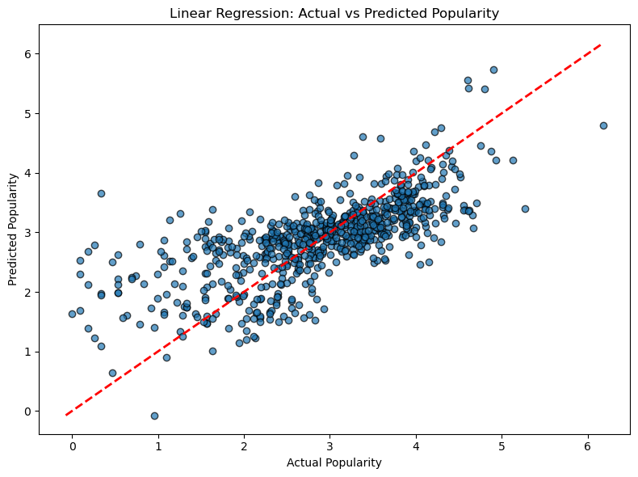
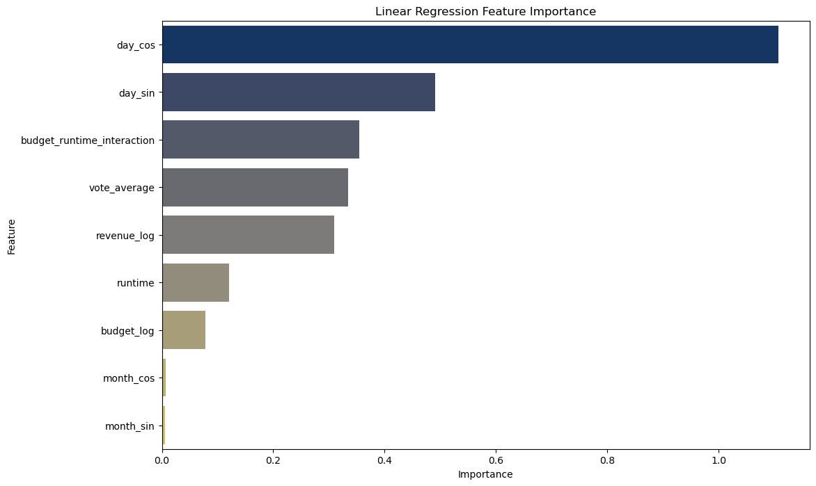
Model 1: Linear Regression
Updated Features: ['budget_log', 'runtime', 'vote_average', 'month_sin', 'month_cos', 'day_sin', 'day_cos', 'revenue_log', 'budget_runtime_interaction']
Root Mean Squared Error (RMSE): 0.6884275084348853 R-squared (R²): 0.5066330266530592
Notes:
Scatter Plot:
shows the relationship between actual and predicted popularity scores
red line represents the ideal scenario where the predicted values would perfectly match the actual values
the RMSE of 68% represents the difference between the predicted and actual scores, so the error is moderate here.
R squared of 50% explains the variance, the model captures around half of the factors contributing to the movies popularity
room for improvement
Feature Importance:
bars represents how much each feature contributes to the predictions
day_cos and day_sin are the most influential features in the model whereas budget_log and month_cos/sin are less impactful

Slide 11
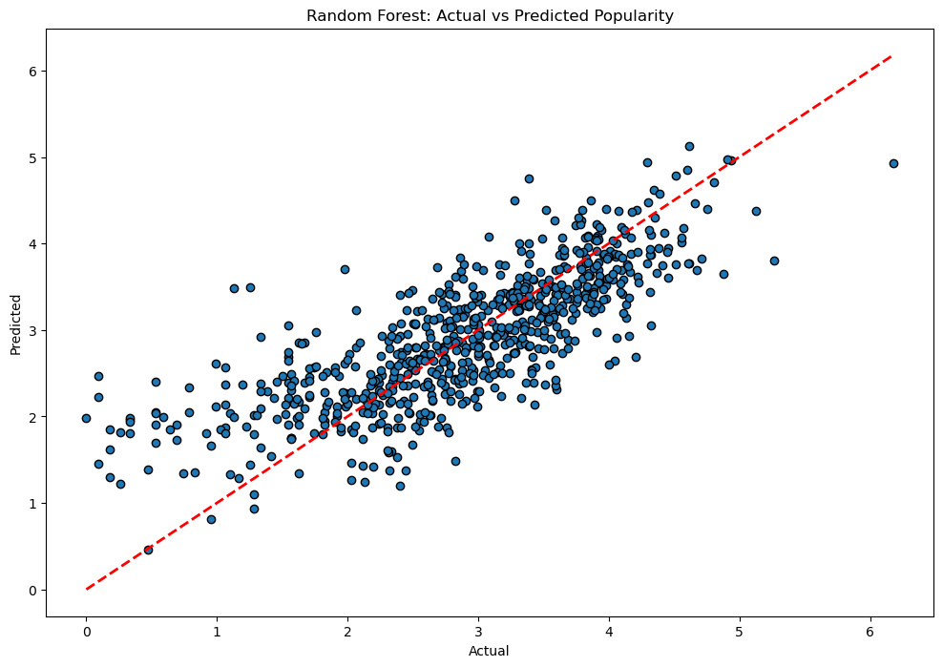
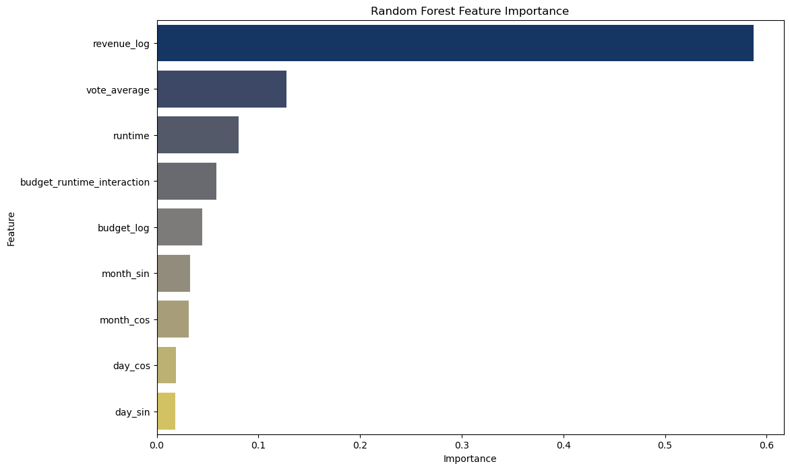
Model 2: Random Forest
Root Mean Squared Error (RMSE): 0.6055005301511441 R-Squared (R²): 0.6183346814644578
Notes:
Scatter Plot:
shows the relationship between actual and predicted popularity scores
red line represents the ideal scenario where the predicted values would perfectly match the actual values
the RMSE of 60% is the error between predicted and actual popularity values, its lower than the linear regression so the random forest is making accurate predictions
R squared of 61% of the features are captured accurately to predict popularity, much better than the linear regression which was 50%
model is struggling to predict highly popular movies
Key Features:

Slide 12

RANDOM FOREST
- Complex Relationships handling
- Feature Importance recognition
- Robustness handling of outlier’s noisy data
- Data Versatility with numerical & categorical
- Predictive Power for unseen data
= Ideal for predicting future movie trends!
Notes:
- Complex Relationships: Random Forests capture intricate, non-linear relationships in movie data (e.g., revenue, budget) better than linear models.
- Feature Importance: They highlight which factors (e.g., genre, actor power) drive movie success, offering insights that Linear Regression may miss.
- Robustness: Random Forests handle outliers and noisy data, such as low-budget blockbusters, more effectively.
- Data Versatility: They work seamlessly with both numerical (revenue, budget) and categorical (genre, awards) data.
- Predictive Power: Random Forests generalize better to unseen data, making them ideal for predicting future movie trends.

Slide 13
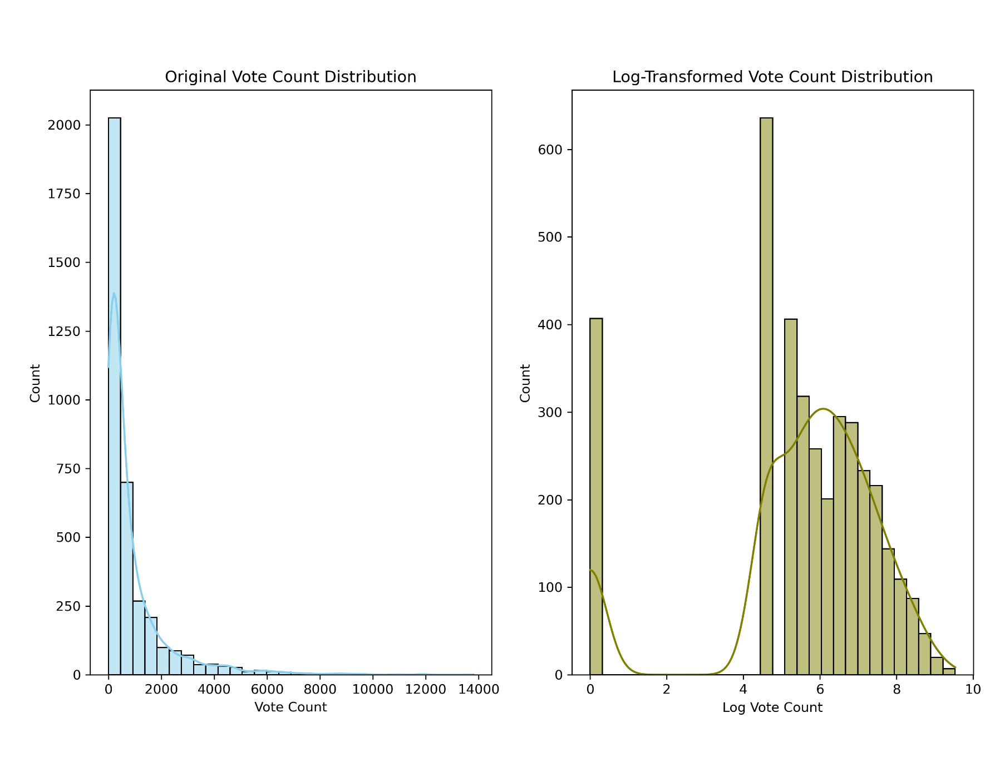
Optimization One: Feature Engineering
Log Transformation: on ‘vote_count’ feature to normalize its distribution
Interaction Features combining ‘vote_count_log’ and ‘vote_average’ to capture the relationship
Seasonal Feature that flags movies released during the Oscar season, in the fall and winter months
Updated Features: ['budget_log', 'revenue_log', 'runtime', 'vote_average', 'release_year', 'budget_runtime_interaction', 'month_sin', 'month_cos', 'day_sin', 'day_cos', 'vote_count_log', 'vote_count_avg_interaction', 'oscar_season']
Notes:
Log Transformation:
normalized the vote count distribution, making it easier for the model to work with and improve predictive power
Interaction Feature:
to capture the non-linear relationship between the number of votes and average rating
provide the model with a more complex understanding of how these two features jointly influence popularity
Seasonal Feature:
flags movies released during fall or winter months (Sep - Dec), prime periods for oscar eligible releases
months tend to attract high-quality films that aim for awards, leading to higher critical attention
account for time related trends in movie popularity and see if time plays a significant role in popularity

Slide 14
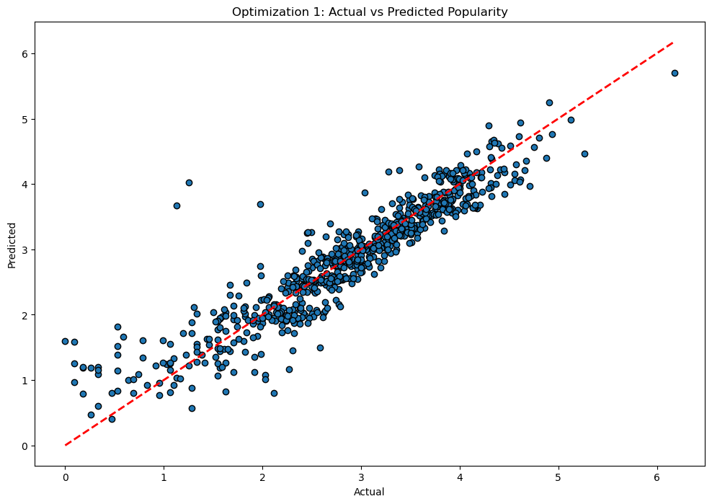
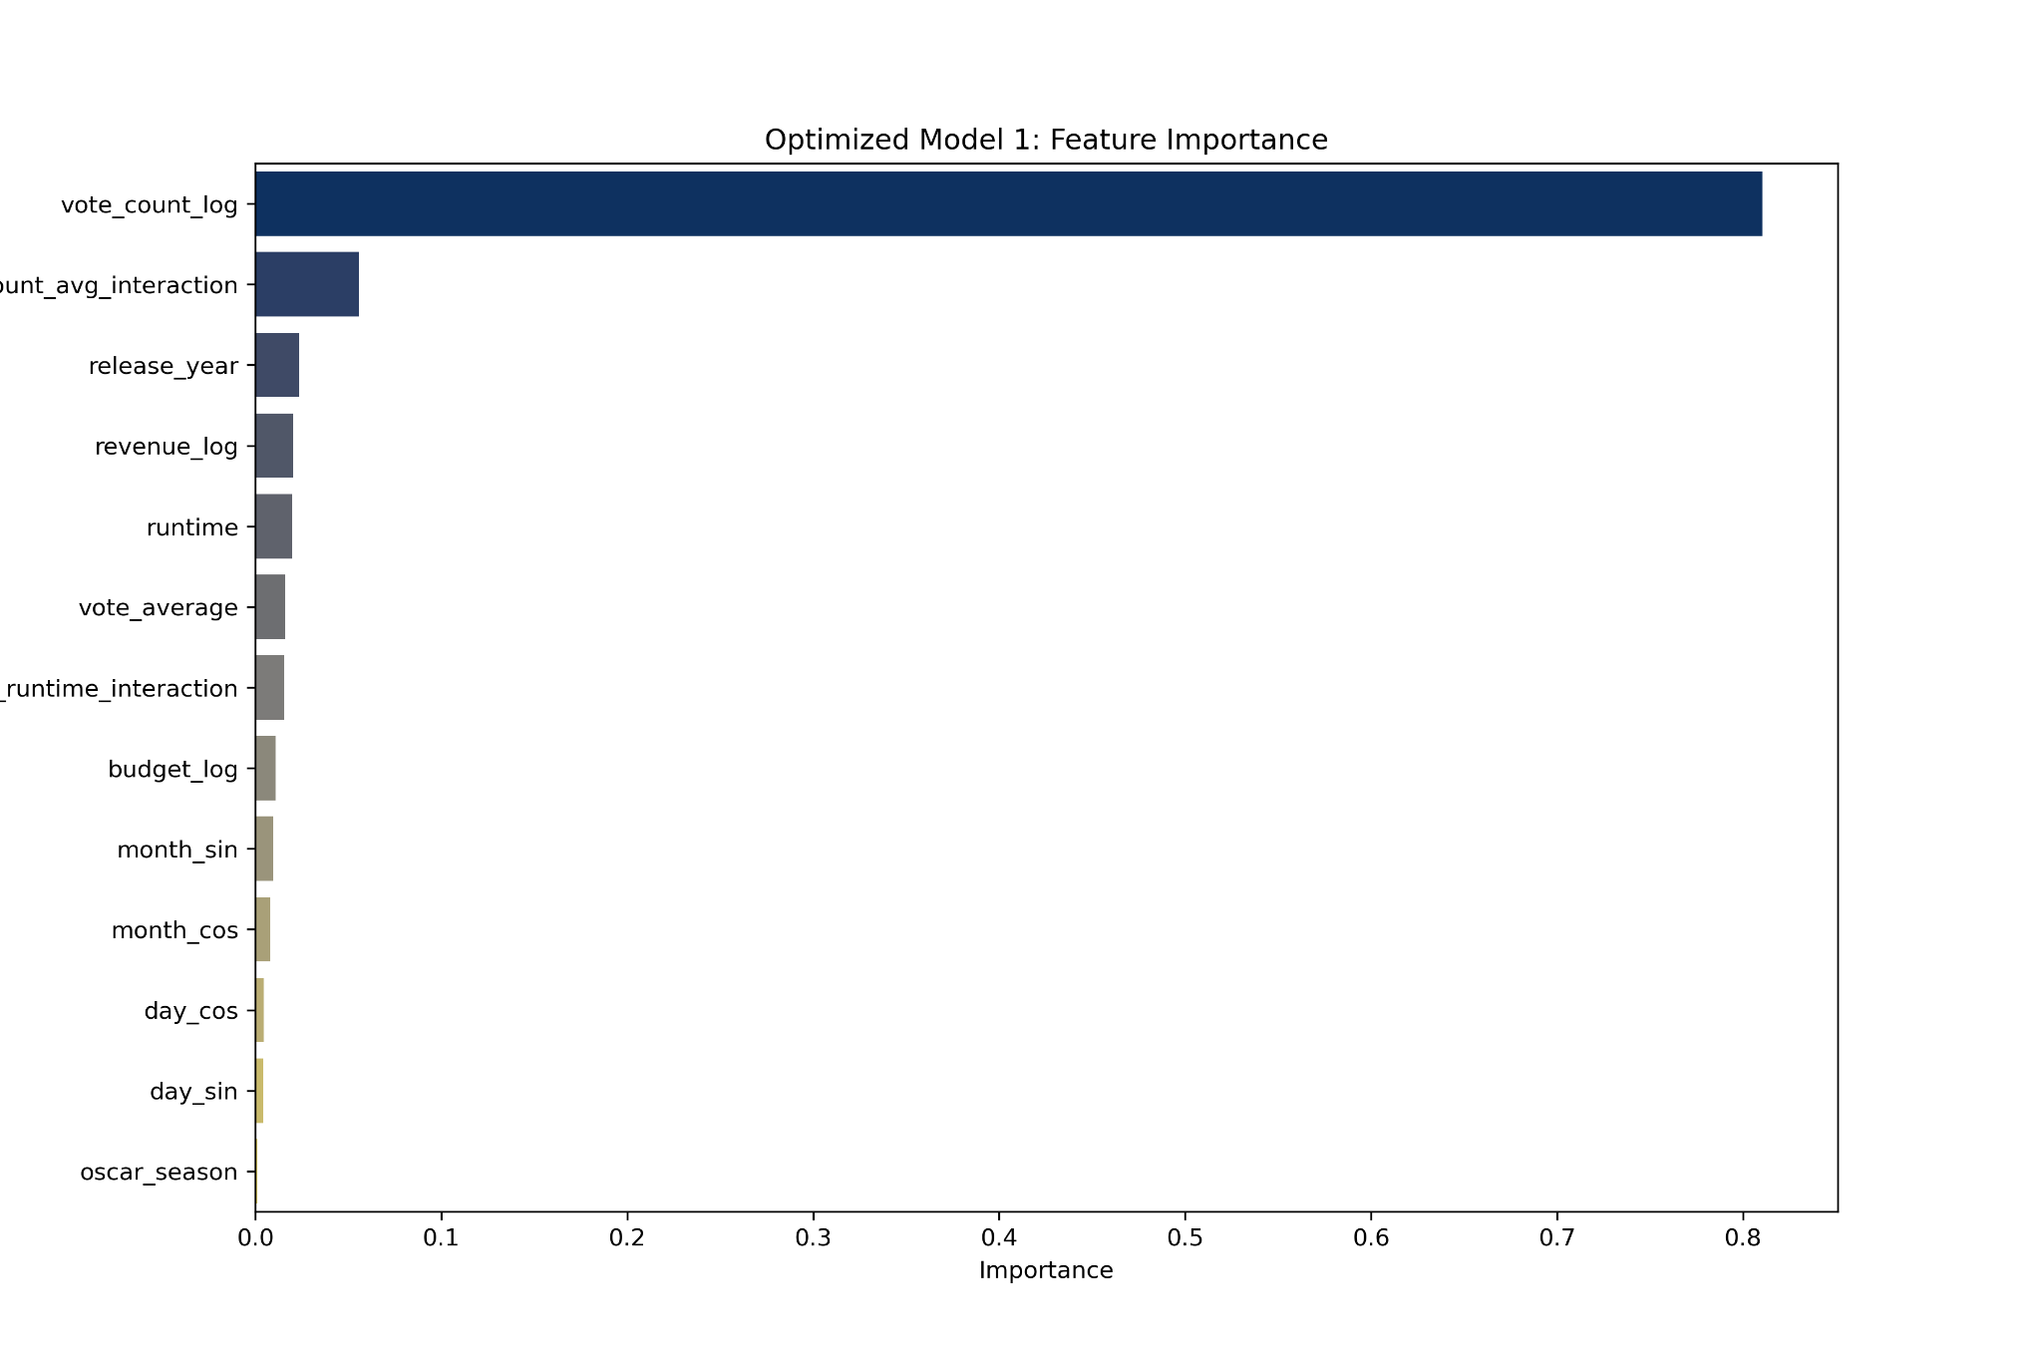
Optimization One Output
Root Mean Squared Error (RMSE): 0.3629928041279302 New R-Squared: 0.8628329893191401
Notes:
Feature Importance:
most important feature is vote count, correlates strongly with popularity
vote count and average interaction is the second highest, captures the relationship between how many people rated the movie and how they rate it.
Scatter plot:
tight clustering of points along the red line reflects strong influence of vote count in predicting popularity
interaction feature helps the model predict higher popularity more accurately
room for improvement
oscar season did help tune the predictions but it is not as important

Slide 15

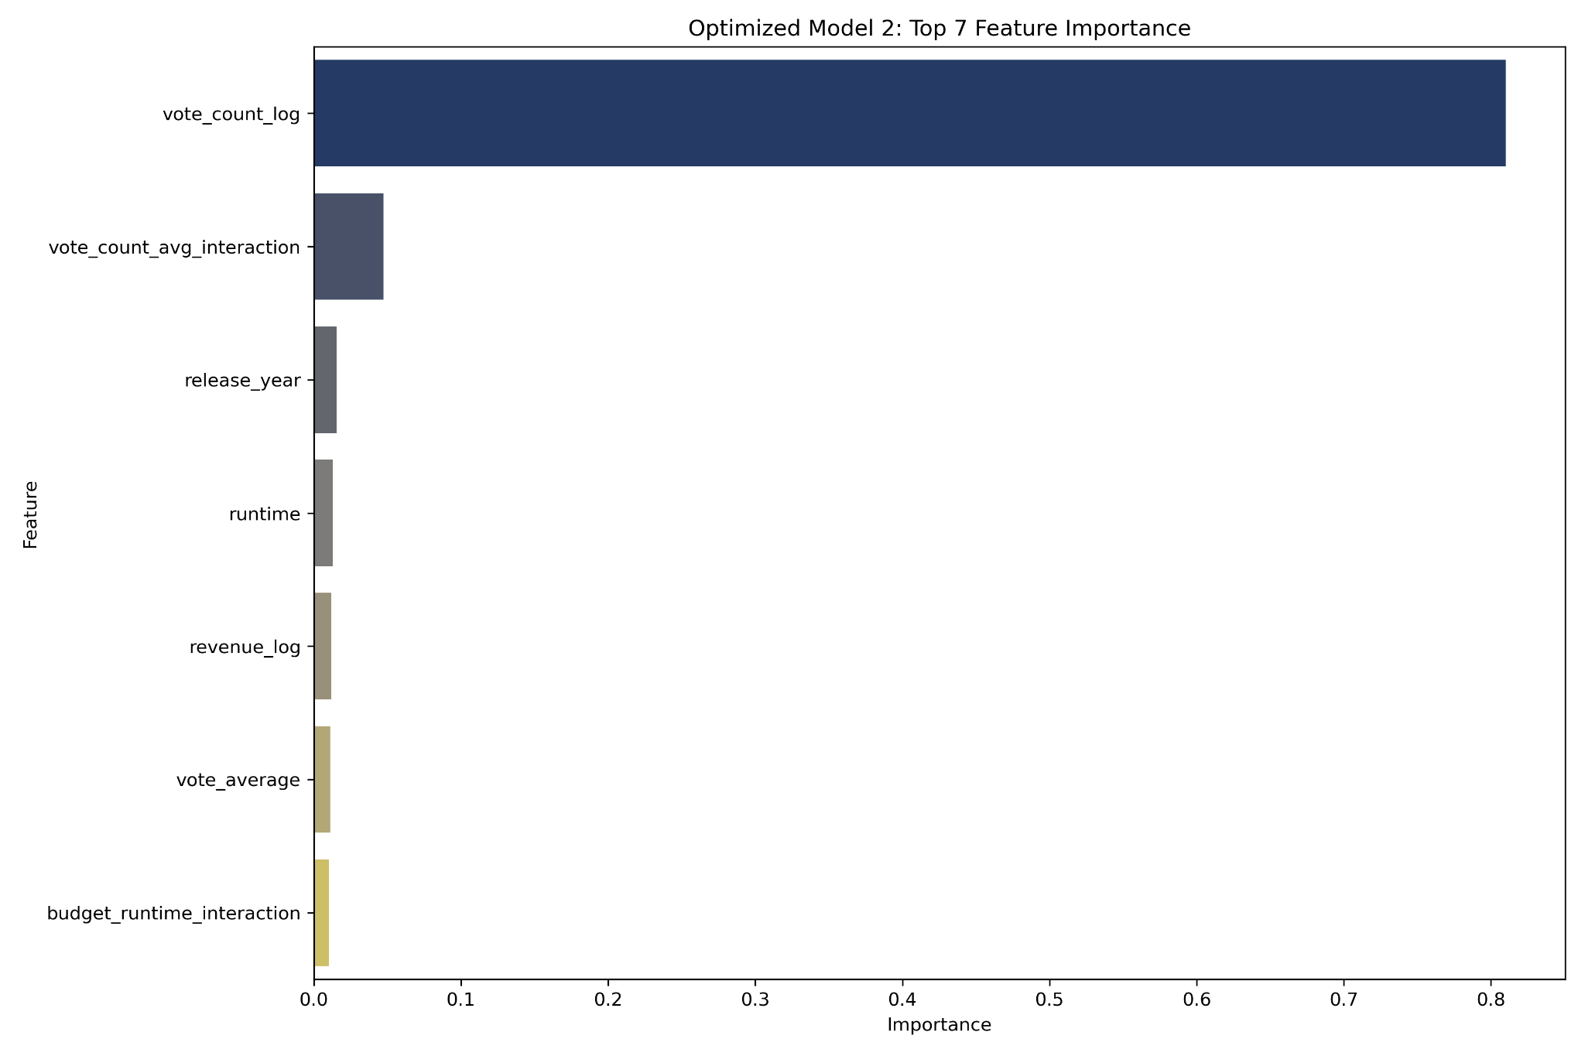
Optimization Two: One-Hot Encoding
One-hot encoding to ‘genres’ and ‘award’ columns Updated Features: optimized one features + encoded_columns
Root Mean Squared Error (RMSE): 0.6055005301511441 R-Squared (R²): 0.8659762242238038
Notes:
Key Observations:
Positive Correlation: The scatter plot shows a strong positive correlation between the actual and predicted popularity values. This indicates that the model is generally predicting popularity accurately.
Clustering Around the Diagonal Line: The data points tend to cluster around the diagonal line, which represents perfect predictions. This suggests that the model is making accurate predictions for most instances.
Scatter Around the Diagonal: While the clustering is strong, there is still some scatter around the diagonal line. This indicates that the model might not be perfectly accurate for every instance.
No Clear Pattern of Bias: There doesn't seem to be a systematic overestimation or underestimation of popularity. The points are fairly evenly distributed around the diagonal line.
Overall Assessment:
The scatter plot suggests that the optimized model is performing well in predicting popularity. The strong positive correlation and clustering around the diagonal line indicate that the model is making accurate predictions for most instances. However, the scatter around the diagonal highlights that there are still some instances where the model might be less accurate.
Key Insights:
Most Important Feature: vote_count_log is the most important feature, contributing significantly to the model's predictions.
Other Important Features: vote_count_avg_interaction, release_year, runtime, revenue_log, vote_average, and budget_runtime_interaction are also considered important features, though to a lesser extent.
Relative Importance: The length of each bar indicates the relative importance of the feature. Longer bars represent features that have a greater impact on the model's predictions.
Interpretation:
Based on this feature importance plot, it can be concluded that the number of votes a movie receives (vote_count_log) is the most crucial factor in determining its success. Additionally, the average interaction per vote (vote_count_avg_interaction), release year, runtime, revenue, average rating, and the interaction between budget and runtime also play significant roles in the model's predictions.

Slide 16
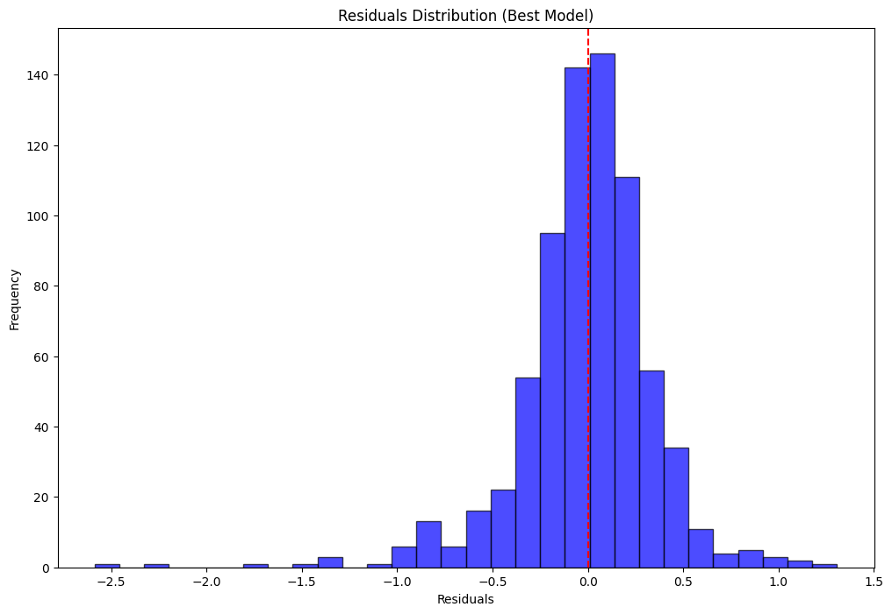
Optimized Residual Distribution
Key Observations:
Skewness: The distribution is slightly right-skewed.
Outliers: There are a few outliers present, suggesting that the model might have struggled to accurately predict some data points.
Clustering around 0: A significant cluster of predictions close to 0, indicating that the model's predictions are generally accurate for many data points.
Overall Assessment:
While the model shows reasonable performance, the presence of skewness and outliers suggests that there might be room for improvement. Further investigation into the data, feature engineering, or model selection could help address these issues and enhance the model's accuracy.
Notes:
Key Observations:
Skewness: The distribution is slightly right-skewed, indicating a tendency for the model to overestimate the target variable.
Outliers: There are a few outliers present, suggesting that the model might have struggled to accurately predict some data points.
Clustering around 0: A significant portion of the residuals cluster around 0, indicating that the model's predictions are generally accurate for many data points.
Overall Assessment:
While the model shows reasonable performance, the presence of skewness and outliers suggests that there might be room for improvement. Further investigation into the data, feature engineering, or model selection could help address these issues and enhance the model's accuracy

Slide 17
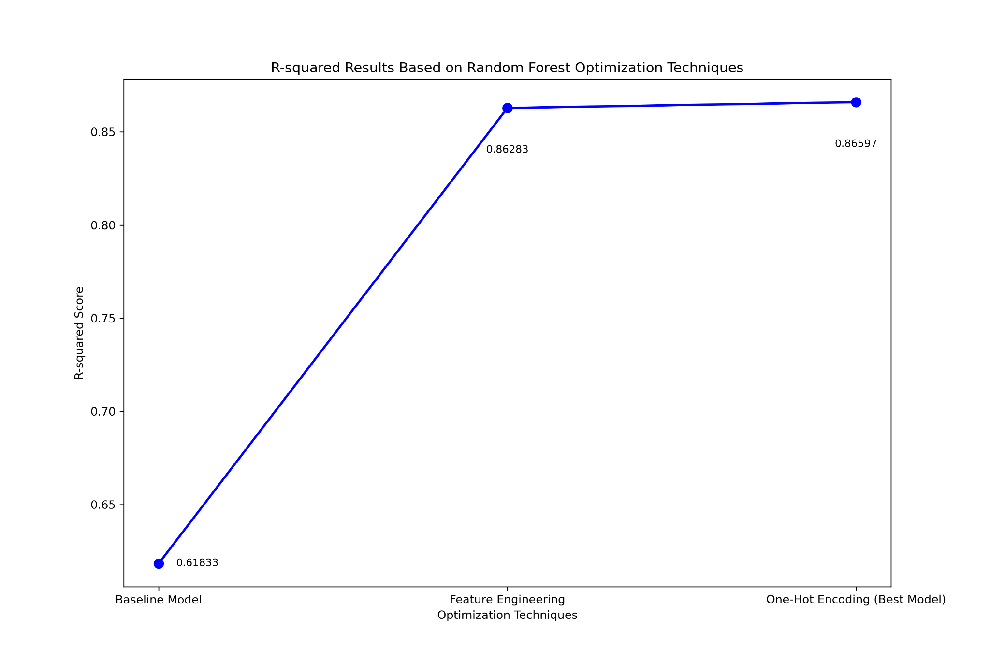
R-squared Results Based on Random Forest Optimization Techniques
1. Baseline Model
Techniques: Log Transformation, Encoding (One-hot or Label), Cyclical Transformation, Interaction Terms
R-squared: 0.61833
2. Feature Engineering
Techniques: Log Transformation, Interaction Features, Seasonal Features (sin/cos)
R-squared: 0.86283
3. One-Hot Encoding
Techniques: One-Hot Encoding for Genres and Awards
R-squared: 0.86597
Visualization Insight:
The plot reveals a clear improvement in model performance as advanced feature engineering and encoding techniques are applied, achieving the highest R-squared score with the Best Model.
The visual presentation showcases the progression and impact of each optimization technique on the model's accuracy.

Slide 18
Questions

Slide 19

Thank You!
Applause !!

